Slide 1
Valuation
Henkel AG vs. Reckitt Benckiser plc
Professor David Wessels ©2010
The Wharton School of the University of Pennsylvania
3620 Locust Walk, Philadelphia PA 19104

Slide 2
Presentation Overview
Understanding a company’s past is essential to forecasting its future. For that reason, we start with an in-depth analysis of historical operating performance.
For Henkel AG, the company struggles to compete against its European Household and Personal Care (HPC) counterparts, and specifically Reckitt Benckiser plc. Henkel lags Reckitt Benckiser in each of the key value drivers: organic revenue growth, operating margin, capital turnover, and financial flexibility.
Part of Henkel’s underperformance can be attributed to the economic downturn and its reliance on Adhesives, which is highly cyclical. Yet even controlling for segment performance, Henkel still remains well below best practice. This presentation will examine each component in detail.

Slide 3
Revenue Growth
Between 2005 and 2009, Reckitt Benckiser has outgrown Henkel AG each and every year. Reckitt Benckiser even managed to record 8.0% organic revenue growth during the global recession of 2009, as compared to Henkel’s -3.5% growth.
Henkel’s low organic growth is not caused by any particularly poor-performing segment. Each division is growing at roughly the same rate.

Slide 4
Revenues by Geography
For both Henkel and Reckitt Benckiser, Europe and North America generate the majority of revenues.
In 2005, developing markets made up a larger portion of revenues for Reckitt Benckiser relative to Henkel.
By 2009, Henkel increased the proportion of its business in developing markets to 18.3%, nearly matching Reckitt Benckiser’s 19.3%.

Slide 5
Operating Margins
Reckitt Benckiser has consistently generated a higher operating margin than Henkel, and this difference has expanded over the last five years. The company’s higher margins are a result of the company’s lower costs of sales, which is likely caused by higher prices from the company’s premium products.

Slide 6
Margins by Segment
Examining operating margins, and treating Reckitt Benckiser as a “pure play” relative to Henkel’s individual segments, Reckitt Benckiser is more profitable each of Henkel’s segments. Operating margins expanded (somewhat) for Henkel’s Cosmetics/Toiletries and Laundry/Home Case businesses, but fell for the industrial adhesives business

Slide 7
Industry Margins
Across the European household and personal care industry (European HPC), Reckitt Benckiser is the clear leader in operating margins. Henkel ranks near the bottom within the industry, and the company reports slightly lower operating margins than its domestic competitor, Beiersdorf AG.

Slide 8
Invested Capital Breakdown
As a percent of sales, Henkel and Reckitt have a very similar amount of operating current assets, operating assets and invested capital.
The primary difference in capital occurs because of PP&E, acquired intangibles, and operating current liabilities. Henkel carries more PP&E and Reckitt Benckiser carries more acquired intangibles.

Slide 9
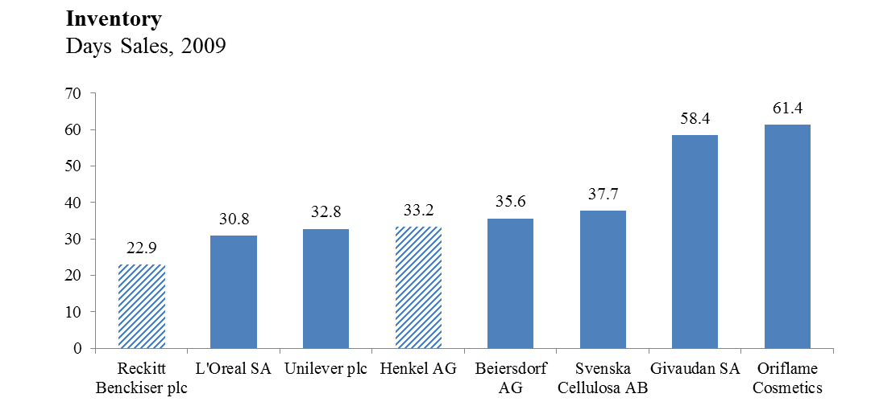
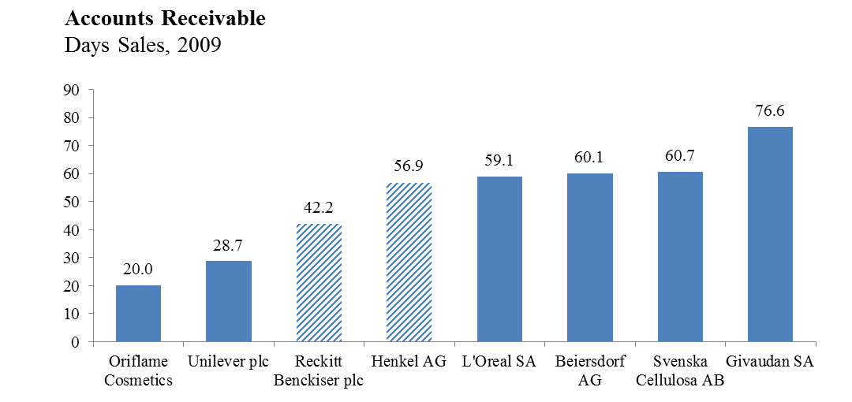
Inventory & Accounts Receivable
Henkel holds inventory and accounts receivable in line with the European HPC industry, but underperforms Reckitt Benckiser in both categories.
In terms of inventory held, Reckitt Benckiser is best practice, holding on average 11.3 fewer inventory days than Henkel.
Reckitt also outperforms Henkel in terms of its accounts receivable collection period, 42.2 (for Reckitt) versus 56.9 (for Henkel).

Slide 10
Financial Health: Debt to EBITA
In addition to generating industry best operating margins, Reckitt Benckiser has tremendous financial flexibility (some would argue too much).
AS part of the acquisition of National Starch in 2008, Henkel raised significant debt. As of 2009, the company would need 3.7 years of EBITA to pay down debt.

